Slide 1

Options for people with uncontrolled epilepsy:
One size does not fit all

Slide 2

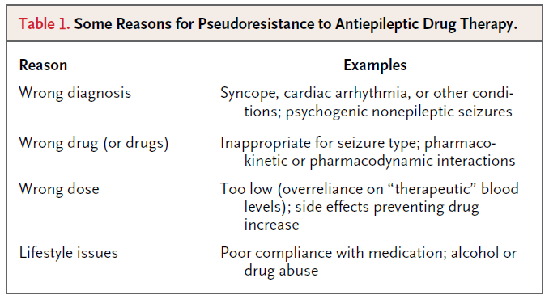

Drug resistant epilepsy: what is it and how does it impact you and your patients?
Drug resistant epilepsy vs Pseudoresistance:
the importance of ruling it out
Drug resistant epilepsy is defined as the failure of adequate trials of two tolerated, appropriately chosen and used antiepileptic drug schedules (whether as monotherapies or in combination) to achieve sustained seizure freedom.¹
Pseudoresistance is an
umbrella term comprising different phenomena that
may mimic resistance to ASMs.²
Despite the fact that there is no widely accepted definition, the term ‘‘pseudoresistance” is commonly used in the context of seizure recurrence due to permanent or occasional lack of adherence to prescribed ASM treatment and/or psychogenic non epileptic seizures (PNES).²
Pseudoresistance, in which seizures persist because the underlying disorder has not been adequately or appropriately treated, must be ruled out or corrected before drug treatment can be considered to have failed.³
Modified table from tab 1 ref 3.
Abbreviations: ASM, antiseizure medication
1. Kwan P et al. Epilepsia (2010); 51(6):1069–1077; 2. Gesche J et al. Epilepsy & Behavior (2022); 130:108633; 3. Kwan P et al. N Engl J Med (2011);365:919-26

Slide 3
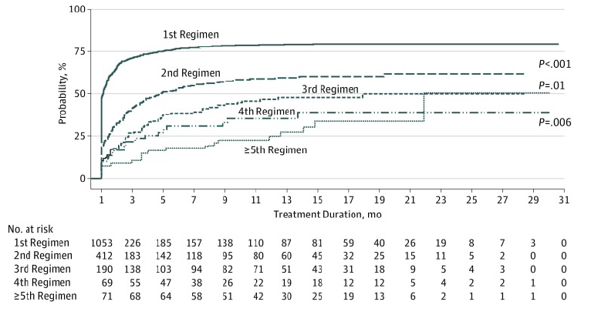
Drug resistant epilepsy: what is it and how does it impact you and your patients?
The probability of seizure freedom diminishes with the number of AED regimens received
Despite availability of many new antiepileptic drugs with differing mechanisms of action, outcomes in newly diagnosed epilepsy have not improved.⁴
Most patients who attain control do so with the first or second AED.⁴
The probability of achieving seizure freedom diminishes substantially with each subsequent AED regimen tried.⁴
More than one-third of patients experience epilepsy that remains uncontrolled.⁴
The study shows a significant difference in overall probability of seizure freedom between patients treated with the first and second AED regimens (hazard ratio [HR],0.52; 95% CI, 0.45-0.60; p< .001).⁴
The difference is also significant when comparing those treated with their second and third AED regimen (HR, 0.71; 95% CI, 0.55-0.92; p= .01). There are no significant differences between the third, fourth, and fifth and greater numbers of AED regimens.⁴
Modified figure from fig 2(A) ref 4. Cumulative Probability of 1-Year Seizure Freedom by Treatment Duration and Number of Antiepileptic Drugs Regimens Tried (Data for all patients)
Abbreviations: AED, Antiepileptic drug; CI, Confidence Interval
4. Chen Z et al. JAMA Neurol. (2018); 75(3): 279–286

Slide 4
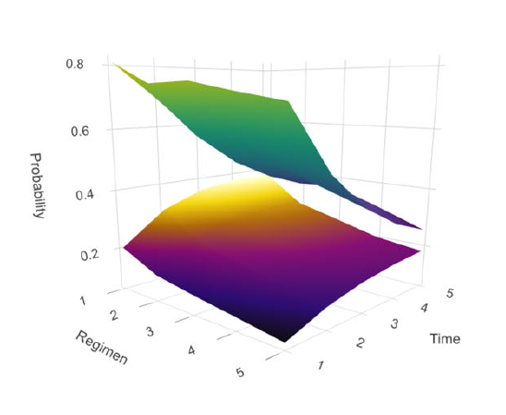
Drug resistant epilepsy: what is it and how does it impact you and your patients?
Probability of achieving future seizure-freedom using a Markov model
Once seizure-freedom is achieved, it is likely to persist, and this effect extends to all regimens in the study. However, this effect is highest with the first ASM regimen and falls with subsequent ASM regimens.⁵
The overall likelihood of achieving long-term seizure freedom is highest with the first ASM regimen and falls as the number of ASM regimens increases.⁵
The benefit of seizure-freedom (separation of the curves/surfaces) is greater initially, and decreased with increasing time and regimen, but remained present for all regimens over 5 years.⁵
Modified figure from fig 6 (D) ref 5. Seizure-freedom in the regimen-based states model. Probability of seizure-freedom with time for each regimen. Green/blue (top) surface = initial state seizure-free; purple/yellow (bottom) surface = initial state not seizure-free.
Abbreviations: ASM, antiseizure medication
5. Simpson HD et al. Brain (2022);145:1326-1337

Slide 5
Drug resistant epilepsy: what is it and how does it impact you and your patients?
Increased risk of SUDEP in uncontrolled epilepsy
Sudden unexpected death in epilepsy (SUDEP) is the most common condition-related cause of death in chronic epilepsy.⁶
Factors significantly associated with SUDEP:⁶
increased frequency of GTCS;
use of polytherapy;
duration of epilepsy;
young age at onset;
gender;
symptomatic etiology
However, this does not mean that people with idiopathic epilepsy or those with a few GTCS per year are protected from SUDEP.⁶
Abbreviations: SUDEP, Sudden Unexpected Death in Epilepsy; GTCS, generalized tonic–clonic seizures
6. Hesdorffer DC et al. Epilepsia (2011); 52(6):1150–1159

Slide 6
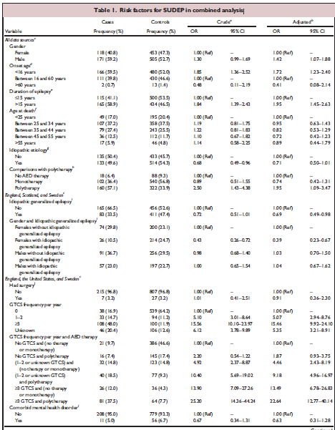
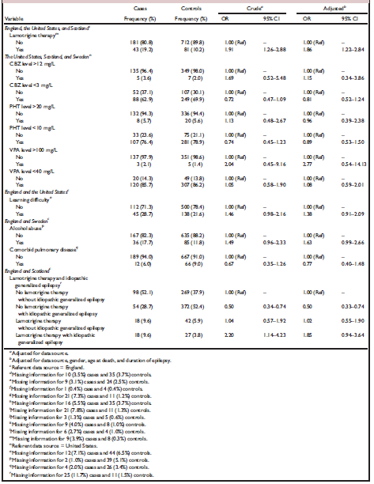
Drug resistant epilepsy: what is it and how does it impact you and your patients?
Increased risk of SUDEP in uncontrolled epilepsy
GTC seizure frequency per year | SUDEP cases, n (%) | Controls, n (%)ª | Crude OR | Crude 95% CI
0 | 38 (16.9) | 539 (64.2) | 1.00 (reference) | –
1‒2 | 33 (14.7) | 94 (11.2) | 5.10 | 3.01, 8.64
≥3 | 108 (48.0) | 100 (11.9) | 15.56 | 10.10, 23.97
Elaborated table from table I ref 6. Risk factors for SUDEP in combined analysis
Abbreviations: SUDEP, Sudden Unexpected Death in Epilepsy; GTCS, generalized tonic–clonic seizures
6. Hesdorffer DC et al. Epilepsia (2011); 52(6):1150–1159

Slide 7
Considerations in selection of ASMs for people with uncontrolled epilepsy:
How to achieve the best outcomes
How does a physician pick the next ASM in a person with uncontrolled seizures?
Selection of ASMs in patients with uncontrolled seizures is generally based on consideration of individual characteristics such as:⁷
seizure type;
epilepsy syndrome;
age;
gender;
lifestyle;
expected compliance;
patient’s expectations.
Other relevant variables include concomitant medications, with the attendant risk of adverse drug interactions, and comorbidities, which could be influenced adversely or beneficially depending on the ASM that is chosen.⁷
When selecting an ASM as first add-on therapy for individuals who did not respond optimally to a single or a sequential monotherapy a neurologist needs to consider the above factors and additional variables, including:⁷
response to previously administered ASMs;
the possibility of pharmacodynamic and/or pharmacokinetic interactions between the ASMs to be combined.
Abbreviations: ASM, antiseizure medication
7. Gambardella A et al. Epilepsy & Behavior (2021); 122: 108087

Slide 8
Considerations in selection of ASMs for people with uncontrolled epilepsy:
How to achieve the best outcomes
From a “disease-oriented” to a “patient oriented” choice of antiepileptic drug
The concept of choice of antiepileptic drugs has changed from “disease-oriented” in the past to “patient-oriented” in the era of new AEDs. Patient-oriented choice of drugs involves selecting the most suitable drug for the patient on the basis of comprehensive multi-dimensional assessment of epilepsy, AEDs, and the patient’s condition.⁸
Modified figure from figure 4 ref 8. Patient-oriented choice of antiepileptic drugs
Abbreviations: AED, antiepileptic drug; Wt, body weight; QoL, quality of life; LRE, localization-related epilepsy; GE, generalized epilepsy;
LGS, Lennox-Gastaut syndrome; JME, juvenile myoclonic epilepsy; EEG, electroencephalography; EBM, evidence-based medicine; RCT, randomized controlled trial
8. Park KM et al. J Epilepsy Res (2019);9(1):14-26

Slide 9
Considerations in selection of ASMs for people with uncontrolled epilepsy:
How to achieve the best outcomes
Can Avoidance of Hepatic Induction Drive ASM Choice?
Enzyme induction was first recognized as a pharmacologic complication of epilepsy treatment >30 years ago.⁹
Lifelong use of enzyme-inducing AEDs, particularly phenobarbital, phenytoin, and carbamazepine, has much broader implications for the patient’s general health than just the production of pharmacokinetic interactions.⁹
Given the range of effective and well-tolerated AEDs now available, enzyme inducers perhaps should not be regarded as drugs of first choice in newly diagnosed epilepsy.⁹
The hazard of incident cardiovascular disease is higher in those receiving eiASMs. The association is dose dependent and the absolute difference in hazard seems to reach clinical significance by approximately 10 years from first exposure.¹⁰
Abbreviations: ASM, antiseizure medication; eiASM, enzyme-inducing antiseizure medication
9. Brodie MJ et al. Epilepsia (2013);54(1):11–27; 10. Josephson CB et al. JAMA Neurol. (2021);78(11):1367-1374

Slide 10

Considerations in selection of ASMs for people with uncontrolled epilepsy:
How to achieve the best outcomes
can Avoidance of Hepatic Induction Drive ASM Choice?
Clinical problems can occur due to pharmacokinetic interactions with other medications either on introduction of the inducer or due to its withdrawal. There is also increasing awareness of endogenous, mostly steroid, pathways, relevant in particular to vitamin D and cholesterol metabolism, which are targets for this process.⁹
Women using systemic hormonal contraception combined with an enzyme-inducing (EI) antiseizure medication (such as phenytoin, carbamazepine, topiramate, phenobarbital, or oxcarbazepine) had a substantially greater rate of unintended pregnancies than those using other combinations of contraception and enzyme-neutral (EN) antiseizure medication (such as lamotrigine, valproate, gabapentin, or levetiracetam).¹¹
Abbreviations: ASM, antiseizure medication; eiASMs, enzyme-inducing ASMs
9. Brodie MJ et al. Epilepsia (2013);54(1):11–27; 11. Anderson S et al. Epilepsy & Behavior (2021); 125: 108368

Slide 11
Take home messages
Epilepsy remains uncontrolled in 1/3 of patients
Failure of 2 adequately tried ASMs implies drug resistance: rule out pseudoresistance
Increased risk of SUDEP in uncontrolled epilepsy
Drug selection is not easy: many factors need to be considered
There is no one size fits all in epilepsy therapy
It is important to assess needs of individual patients
ASMs are still mainstay treatments but still empirical rather than rational
A complete “holistic” toolkit is required for best individual outcomes
Don’t over treat, don’t under treat, treat right
Avoid overtreatment and undertreatment: there is no place for therapeutic nihilism in epilepsy
Abbreviations: ASM, antiseizure medication

Slide 12
REFERENCES
1. Kwan P et al. Epilepsia (2010); 51(6):1069–1077; 2. Gesche J et al. Epilepsy & Behavior (2022); 130:108633; 3. Kwan P et al. N Engl J Med (2011);365:919-26; 4. Chen Z et al. JAMA Neurol. (2018); 75(3): 279–286; 5. Simpson HD et al. Brain (2022);145:1326-1337; 6. Hesdorffer DC et al. Epilepsia (2011); 52(6):1150–1159; 7. Gambardella A et al. Epilepsy & Behavior (2021); 122: 108087; 8. Park KM et al. J Epilepsy Res (2019);9(1):14-26; 9. Brodie MJ et al. Epilepsia (2013);54(1):11–27; 10. Josephson CB et al. JAMA Neurol. (2021);78(11):1367-1374; 11. Anderson S et al. Epilepsy & Behavior (2021); 125: 108368

Slide 13
DK17449P, NO17448P, SW17446P, FI17447P may 2023

